Slide 1
Project Architecture
Overall software architecture description and images

Slide 2
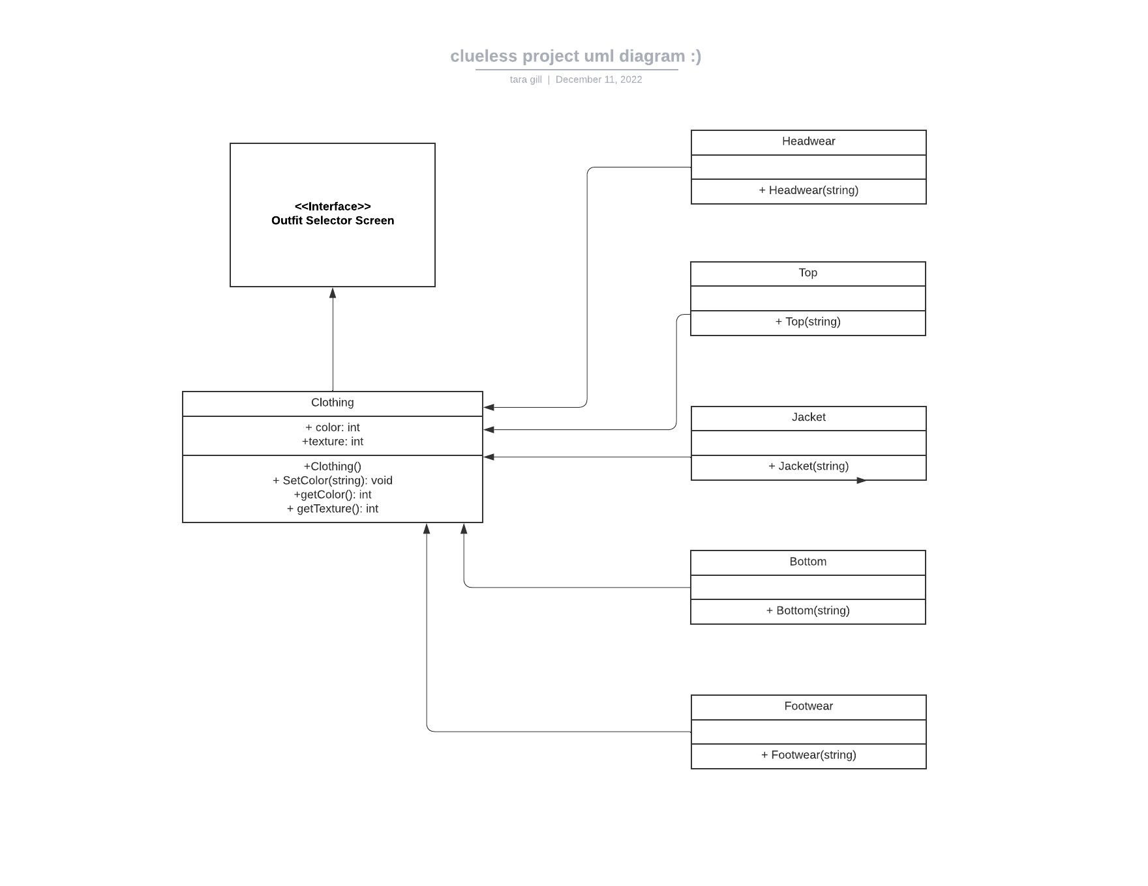
UML Diagram
OOP with Clothing base class and different articles of clothing deriving its members

Slide 3
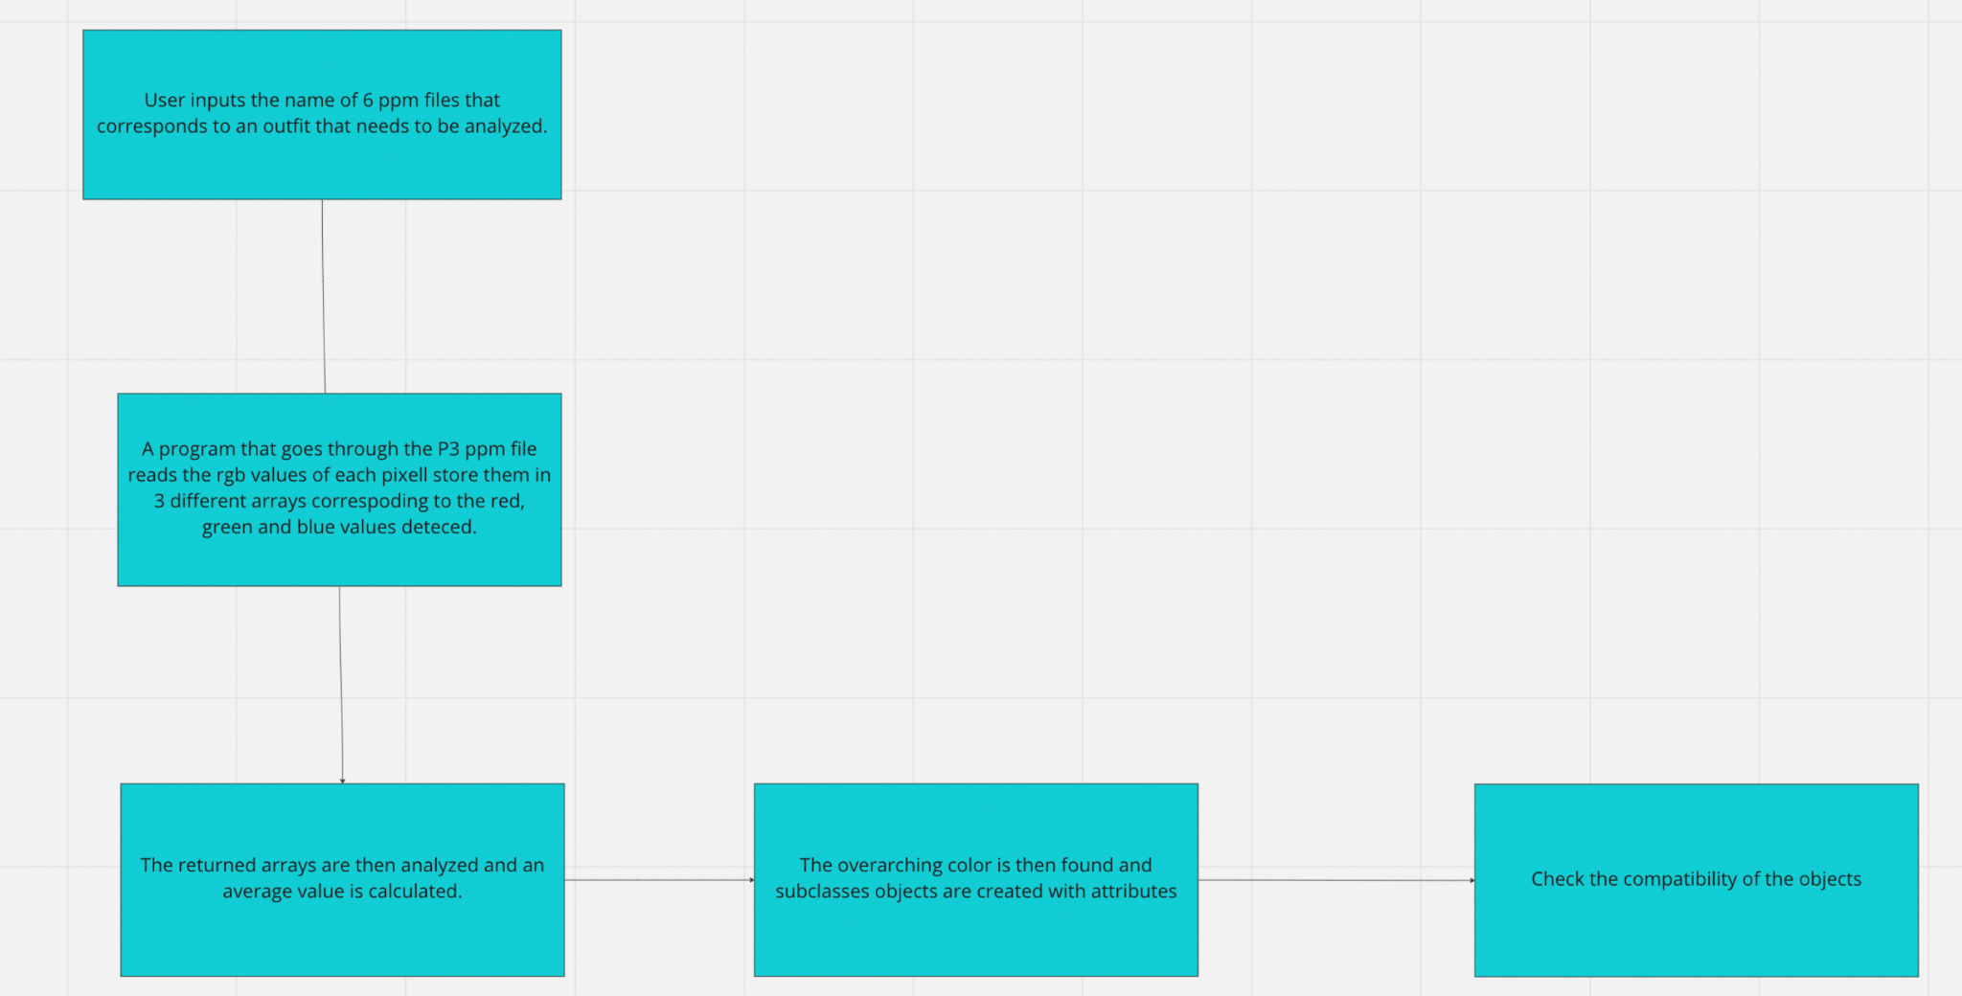
Code flow chart

Slide 4
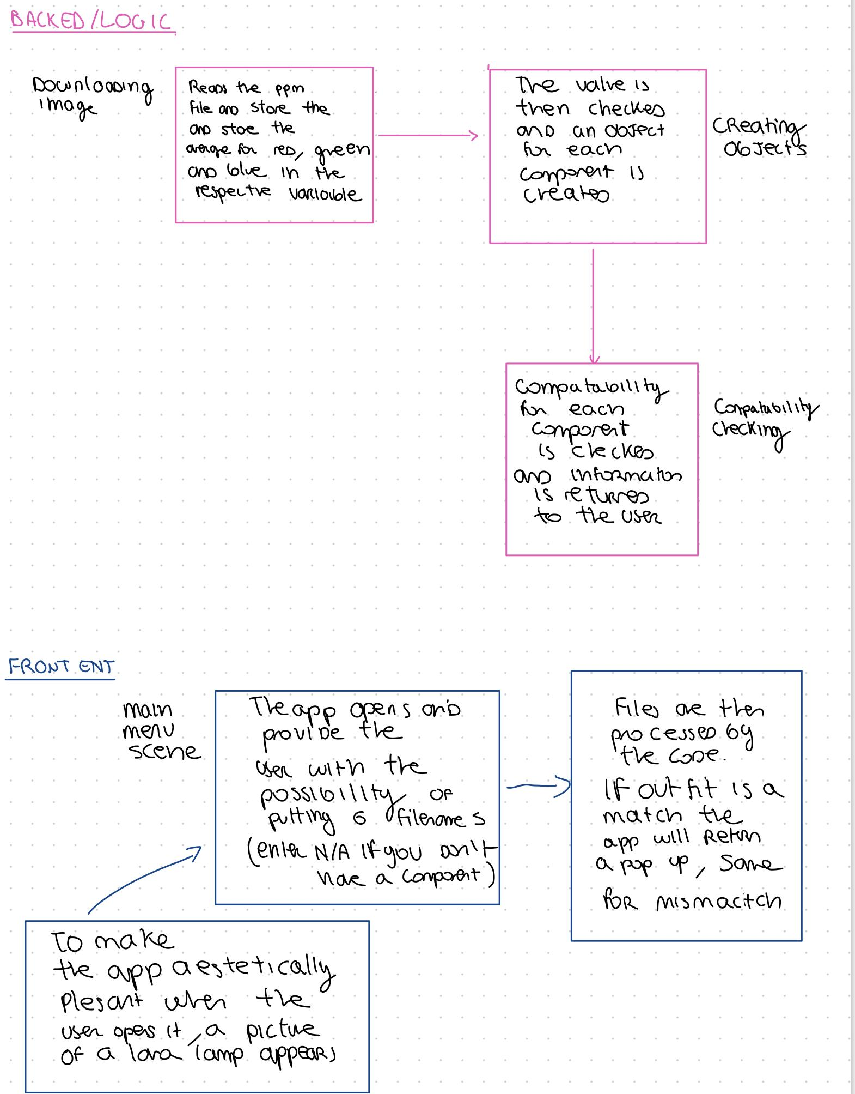
High level diagram

Slide 5
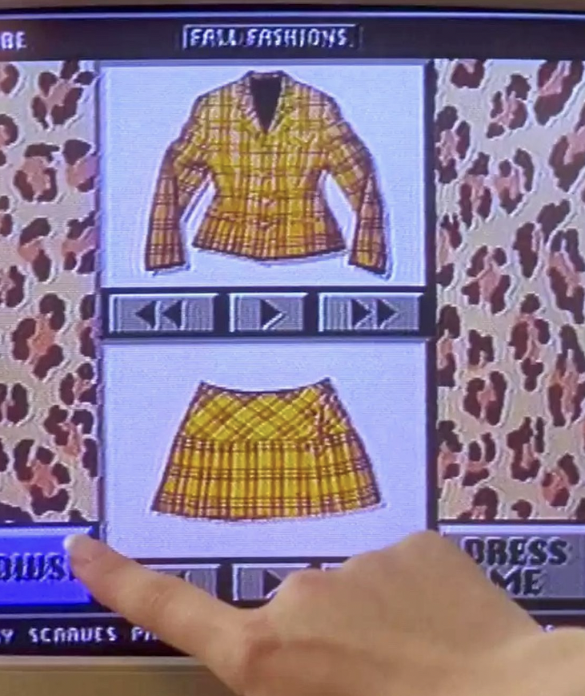
How the code is organized
One folder which contains all the functions for the image processing files
OutfitSelector file is our main function
Separate files for the base and derived class each with its .cpp and .h
Functions with .cpp and for
the color detecting
the conditions needed for an outfit to be considered a match
Misc Folder for the test case images
Folder with the interface/front-end code

Slide 6
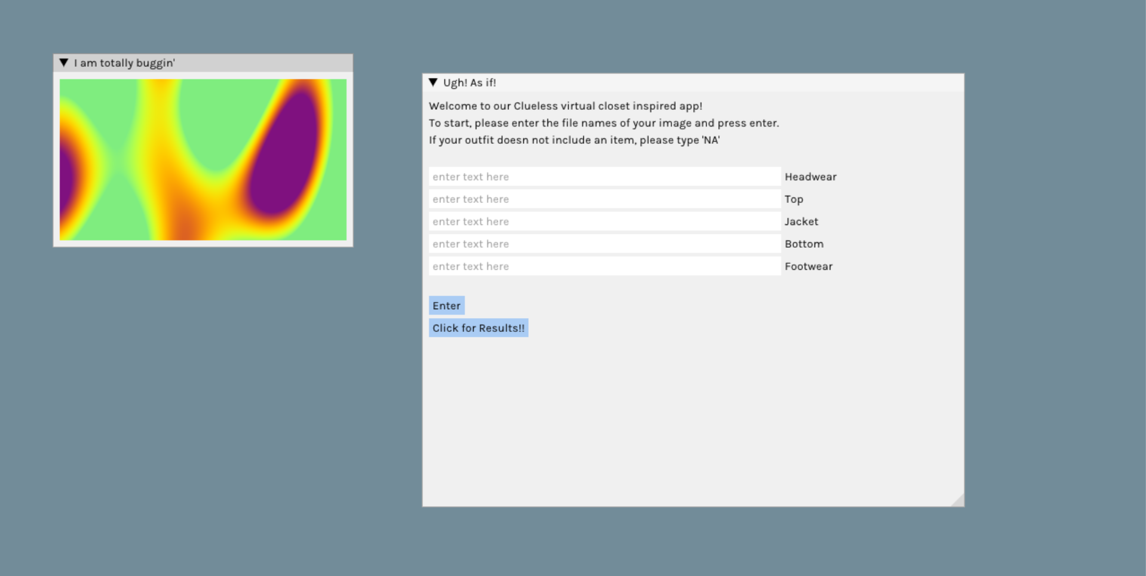
Interface: App

Slide 7
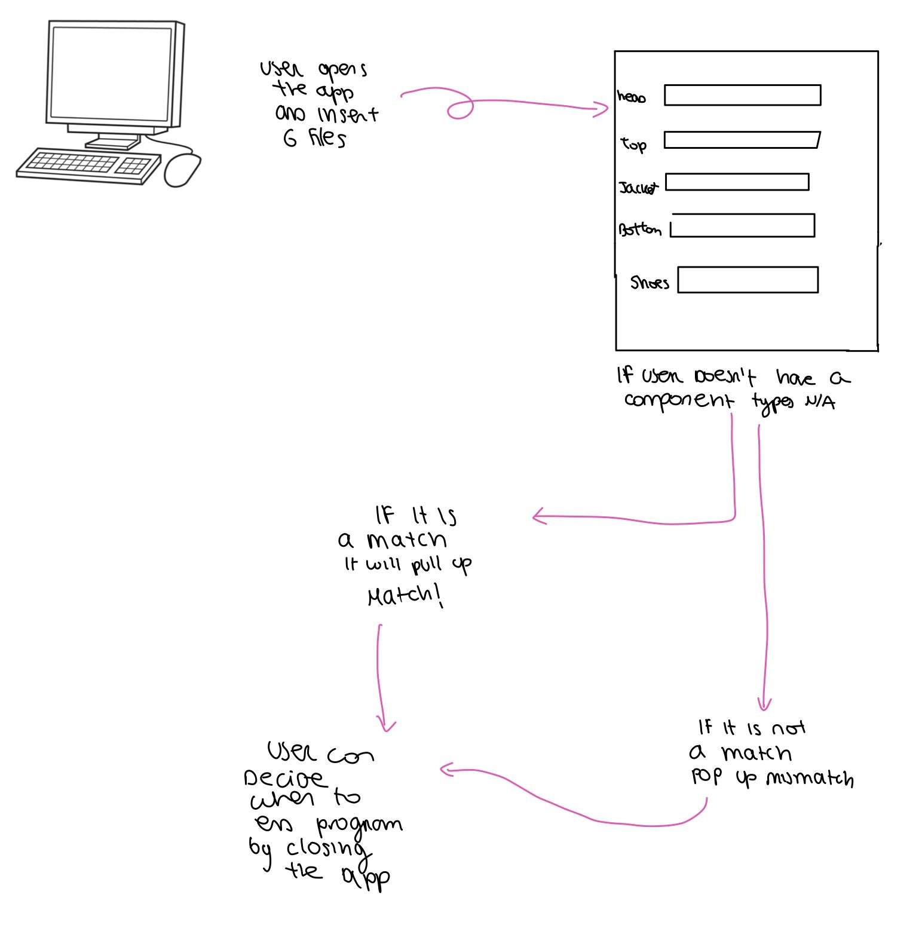
App function

